Slide 1


GMR Institute of Technology, Rajam
Medicinal Leaf Identification using Deep Learning Techniques.
25-Sep-24
1
25-Sep-24
1

Slide 2
Medicinal Leaf Identification using Deep Learning Techniques.
B. Surya Charan (22341A0515)
B. Surya Charan (22341A0515)
Under the guidance of
Dr.P.Kanchanmala Mam
Associate Professor
GMR Institute of Technology

Slide 3
Abstract
A big part of people all over the world uses medicine from plants as an important way to heal and as a substitute for regular medicines.New progress in computer vision technology has quickly advanced the area of plant recognition using pictures. Researchers have found that these methods are very precise, accurate, and useful. The objective of this research is to develop precise methods for the automatic recognition of medicinal plants. However, varying light conditions make it hard to tell a leaf apart from its background. We suggest a way to tell what kind of plant it is by looking at its leaves. We've created a new set of pictures showing different medicinal plants, each with one to ten different types. The technique uses special computer programs called CNNs to automatically find important details in pictures of plants. The CNN model learns from large, high-quality photos of different medicinal plants. With unique traits like leaf shape, color, and feel, the model can spot lots of different plants. Users take pictures of plants with a new system using a phone or small device for instant identification on mobile or built-in devices.
Keywords:
Medicinal Plants,Plant recognition,Convolutional Neural Networks(CNNs),
Automatic Identification,Computer vision.

Slide 4
Introduction
Medicinal plants have played a crucial role in traditional and modern medicine, serving as a primary source of therapeutic compounds and offering alternatives to synthetic pharmaceuticals. As a significant portion of the global population continues to rely on these natural remedies, the need for accurate and efficient identification methods has become increasingly important. Recent advancements in computer vision and deep learning have opened new avenues for automated plant recognition from images. These technologies enable the extraction of intricate visual features, allowing for higher precision and accuracy in identifying various plant species. Convolutional neural networks (CNNs), a prominent architecture in deep learning, have shown exceptional performance in image classification tasks, making them ideal for the identification of medicinal plants.
In this study, we propose a novel approach to the automatic identification of medicinal plants based on leaf morphology, utilizing a newly created dataset of high-resolution images encompassing a diverse range of species. By employing CNNs for feature extraction and classification, our system aims to provide rapid and reliable plant identification through mobile devices. The findings of this research not only contribute to the field of plant taxonomy but also support the sustainable use of medicinal plants by enhancing accessibility for herbalists, researchers, and enthusiasts alike.

Slide 5
Base Paper
Girinth, S., Neeraja, P., Kumar, M. S., Kalyani, S., Mamatha, B. L., & GruhaLakshmi, N. R. T.(2024, March). Real-Time Identification of Medicinal Plants Using Deep Learning Techniques. IEEE.
Objective
1.Develop a real-time plant identification system-This objective focuses on creating a system capable of identifying medicinal plants instantly, improving accessibility and usability in real-world scenarios.
2. Apply deep learning techniques for accuracy-Deep learning models are leveraged to enhance the precision and reliability of plant identification, ensuring accurate classification even with complex or similar-looking species.
3. Automate medicinal plant classification process-The goal is to automate the entire identification and classification workflow, reducing human intervention and improving the speed of analysis.
4. Utilize image processing for plant recognition-Advanced image processing techniques are employed to extract and analyze features from plant images, facilitating better recognition of medicinal plants from various environments.

Slide 6
Overview of the proposed work or Existing Work
Existing works in the field of medicinal plant identification using deep learning have explored various CNN-based methodologies to achieve accurate recognition. For instance, Girinth et al. (2024) employed a real-time CNN model to identify medicinal plants, achieving an accuracy of 90.5% on a targeted set of plant species. Their approach is notable for its real-time processing capabilities but is limited by the small dataset used, which may restrict the model's generalization to a broader variety of plants. Similarly, Giridhar et al. (2024) integrated transfer learning into a CNN framework to improve recognition performance, reaching an accuracy of 88.9%. While this approach benefits from the features learned in pre-trained models, it is constrained by the initial model's capabilities and the limited number of plant classes included. Sharrab et al. (2023) focused on augmenting their dataset to enhance a CNN model's learning, resulting in 85.3% accuracy, although it slightly lags behind the newer studies in terms of accuracy. This approach underlines the value of data augmentation in boosting performance, even with smaller datasets. Together, these studies demonstrate the potential of deep learning in medicinal plant identification while highlighting challenges such as dataset limitations and the need for broader generalization across plant species.

Slide 7
Literature Survey

Slide 8
Literature survey
Reference 1
Kumar, P., & Kumar, V. (2024, March). CNN and Edge-based Segmentation for the Identification of Medicinal Plants. In 2024 5th International Conference on Intelligent Communication Technologies and Virtual Mobile Networks (ICICV) (pp. 89-94),IEEE.
Main Objective
Improve medicinal plant identification accuracy.
Combine CNN with edge-based segmentation for better feature extraction
Technologies Used
Convolutional Neural Networks (CNN) for feature extraction.
Edge-based segmentation to delineate plant structures.
Image processing techniques for image enhancement.
Model Accuracy
92%-95% depending on dataset and plant species.
Limitations
Limited dataset for training the model.
Variability in plant appearances affects accuracy.

Slide 9
Literature survey
Reference 2
Giridharan, N., Sulthana, R. A., Mohanraj, R., & Murugan, M. S.(2024, June). A Deep Learning Approach for Herbal Plant Detection and Recognition. In 2024 3rd International Conference on Applied Artificial Intelligence and Computing (ICAAIC) (pp. 343-347). ΙΕΕΕ.
Main Objective
Developing a system for herbal plant detection and Utilize deep learning for improved recognition accuracy with Automate plant classification based on image inputs.
Technologies Used
Convolutional Neural Networks (CNN).
Image processing algorithms.
Model Accuracy
Achieved accuracy: 90%-93%.
Limitations
Limited plant species in dataset.
Variability in natural lighting affects recognization.

Slide 10
Literature survey
Reference 3
Rebekha, R., Eswaran, S., Hariharan, L., & Manoj, A.* (2024). Medicinal plant identification using machine learning algorithms. International Journal of Advanced Research in Science, Communication and Technology (IJARSCT), 4(8).
Main Objective
Identify medicinal plants using machine learning and developing a model to classify various plant species . Improving classification accuracy through algorithm optimization.
Technologies Used
Decision Trees.
Support Vector Machines(SVM) & CNN
Model Accuracy
Achieved accuracy: 85%-88%.
Limitations
Data size is insufficient.
Requires enhanced feature extraction for complex species.

Slide 11
Literature survey
Reference 4
Sharrab, Y., Al-Fraihat, D., Tarawneh, M., & Sharieh, A.(2023, June). Medicinal plants recognition using deep learning. In 2023 International Conference on Multimedia Computing, Networking and Applications (MCNA) (pp. 116-122). ΙΕΕΕ.
Main Objective
Develop a deep learning model for plant recognition, Classifying medicinal plants using image data and enhancing accuracy for diverse plant datasets
Technologies Used
Deep Neural Networks (DNN).
Image augmentation techniques.
Model Accuracy
Achieved accuracy: 87%-90%.
Limitations
Model performance drops with low quality images.
Time-consuming training process for large dataset.

Slide 12
Literature survey
Reference 5
Kavitha, S., Kumar, T. S., Naresh, E., Kilmany, V. H., Bamane, K. D., & Pareek, P. K.* (2023). Medicinal Plant Identification in Real-Time Using Deep Learning Model. SN Computer Science, 5(1), 73.
Main Objective
Identify medicinal plants in real-time, Utilizing deep learning to improve accuracy and Developing a scalable model for real-time applications.
Technologies Used
CNN for feature extraction.
Real-time Image processing algorithms.
Model Accuracy
Achieved accuracy: 92%-94%.
Limitations
High Computational resources required for real-time processing.
Model struggles with similar plant issues.

Slide 13
Literature survey
Reference 6
Saunshi, G., Chini, S., Ganvatkar, P., & Nayak, R.* (2023, October). Identification and Classification of Medicinal Leaves and their Medicinal Values. In 2023 4th IEEE Global Conference for Advancement in Technology (GCAT) (pp. 1-4). ΙΕΕΕ.
Main Objective
Classify medicinal leaves based on features, Analyzing their medicinal values and Improving leaf classification using deep learning.
Technologies Used
CNN for leaf image classification.
Feature Extraction using Image processing techniques.
Model Accuracy
Achieved accuracy: 89%-91%.
Limitations
Model lacks flexiblility for environmental variations.
Limited datasets affects model generalization.

Slide 14
Literature survey
Reference 7
Salian, P., Shrisha, H. S., Salian, S., & Karthik, K. (2023, November). MPInet: Medicinal Plants Identification using Deep Learning. In 2023 7th International Conference on Electronics, Communication and Aerospace Technology (ICECA) (pp. 654-657). ΙΕΕΕ.
Main Objective
Develop MPInet for medicinal plant identification, Use deep learning for high accuracy plant detection and achieve robust classification for diverse plant species.
Technologies Used
MPInet deep learning model.
CNN based feature extraction.
Model Accuracy
Achieved accuracy: 93%-95%.
Limitations
High resource consumption during training.
Requires extensive dataset for accuracy.

Slide 15
Literature survey
Reference 8
Chamanth, S., Begam, M. F., Chandan, N. S., & Girish, G. S.* (2023, December). Medicinal Plants Attribute Detection by Deep learning Image Processing Techniques. In 2023 4th International Conference on Communication, Computing and Industry 6.0 (C216) (pp. 1-5). ΙΕΕΕ.
Main Objective
Detect plant attributes using deep learning, Improve plant classification using image processing and Develop a model for automatic for feature extraction.
Technologies Used
Deep Learning Algorithms(CNN).
Image segmentation techniques.
Model Accuracy
Achieved accuracy: 88%-90%.
Limitations
High Complexity in feature extraction.
Inconsistence performance in real-world settings.

Slide 16
Literature survey
Reference 9
Rao, R. U., Lahari, M. S., Sri, K. P., Srujana, K. Y., & Yaswanth, D. (2022). Identification of medicinal plants using deep learning. Int J Res Appl Sci Eng Technol, 10, 306-22.
Main Objective
Identifying medicinal plants using deep learning, Improving classification efficiency through automated models and Developing a robust plant classification system.
Technologies Used
Convolutional Neural Networks (CNN).
Feature extraction techniques.
Model Accuracy
Achieved accuracy: 85%-88%.
Limitations
Insufficient data size.
High training time for complex models.

Slide 17
Literature survey
Reference 10
Abdollahi, J.(2022, February). Identification of medicinal plants in ardabil using deep learning: identification of medicinal plants using deep learning. In 2022 27th International computer conference, computer society of Iran (CSICC) (pp. 1-6). ΙΕΕΕ.
Main Objective
Identifying medicinal plants in Ardabil using deep learning, Developing an accurate plant identification system and Classifying plants using image-based deep learning models.
Technologies Used
CNN for plant classification.
Image processing techniques.
Model Accuracy
Achieved accuracy: 87%-90%.
Limitations
Dataset limited to Ardabil region.
Variations in plant species affect Accuracy.

Slide 18
Literature survey
Reference 11
Geerthana, R., Nandhini, P., & Suriyakala, R.* (2021). Medicinal Plant Identification Using Deep Learning. International Research Journal on Advanced Science Hub, 3, 48-53.
Main Objective
Identifying medicinal plants using deep learning, Automating the plant classification process and Using deep learning for higher accuracy.
Technologies Used
CNN for feature extraction.
Image processing and Classification Algorithms.
Model Accuracy
Achieved accuracy: 85%-88%.
Limitations
Limited Training Data.
High Computational resource requirement.

Slide 19
Literature survey
Reference 12
He, K., Zhang, X., Ren, S., & Sun, J.* (2016). Deep residual learning for image recognition. In Proceedings of the IEEE conference on computer vision and pattern recognition (pp. 770-778).
Main Objective
Introducing deep residual networks(ResNet) to address vanishing gradient issues in deep networks, Improving image recognisation accuracy by leverging residual learning.
Technologies Used
Residual Network(ResNet)
Stacked convolutional layers with identity mappings (skip connections).
Model Accuracy
Top-5 error rate on ImageNet: 3.57%.
Limitations
Lack of Standardised datasets for comparing different models.
Limited generalization to unseen plant species.

Slide 20
Literature survey
Reference 13
Mulugeta, A. K., Sharma, D. P., & Mesfin, A. H.* (2024). Deep learning for medicinal plant species classification and recognition: a systematic review. Frontiers in Plant Science, 14, 1286088.
Main Objective
Reviewing recent advances in deep learning applications for medicinal plant classification and Identifying effective deep learning architecture for plant species recognition.
Technologies Used
Various CNN architectures(ResNet, AlexNet, VGG)
Transfer Learning techniques.
Model Accuracy
Varies based on the specific model but typically 85%-95% depending on the dataset.
Limitations
Lack of Standardized dataset for comparing different models.
High variance in performance due to environmental factors.

Slide 21
Literature survey
Reference 14
Azadnia, R., Al-Amidi, M. M., Mohammadi, H., Cifci, M. A., Daryab, A., & Cavallo, E. (2022). An AI based approach for medicinal plant identification using deep CNN based on global average pooling. Agronomy, 12(11), 2723.
Main Objective
Developing a deep learning model using global average pooling for medicinal plant identification and Improving classification accuracy by reducing overfitting with global average pooling.
Technologies Used
Deep CNN with Global Average Pooling(GAP)
Image processing techniques for pre-processing.
Model Accuracy
Achieved accuracy: 92%-94%.
Limitations
Model accuracy will degrade with noisy or low quality images.
GAP may loss fine detials for complex plant structures.

Slide 22
Literature survey
Reference 15
Prasad, R. M., Bhavana, G. M., Manasa, S., Nithya, G., & Nisarga, K. C. (2024). Identification and classification of medicinal plants using deep learning. International Journal of Scientific Research in Engineering and Management (IJSREM), 8(3).
Main Objective
Developing a deep learning model to classify medicinal plants from images and identifying distinct features of medicinal plants to improve classification.
Technologies Used
CNN for Image feature extraction.
Data Augmentation techniques to improve model robustness.
Model Accuracy
Achieved accuracy: 88%-91%.
Limitations
Limited Dataset variety leads to overfitting on certain plant species.
Model performance decreases with environmental noise or complex backgrounds.

Slide 23
Comparison Table
 | Title | year | Objectives | Limitations | Advantages | Performance metrics | Gaps
Reference 1 | CNN and Edge-based Segmentation for the Identification of Medicinal Plants | 2024 | Edge detection and Improve plant segmentation. It combines CNN with edge-based segmentation for accuracy. | High computational requirements and Limited scalability . | Robust segmentation and Efficient feature extraction | Accuracy:95%, | Not optimized for large datasets .
Reference 2 | A Deep Learning Approach for Herbal Plant Detection and Recognition | 2024 | . This paper proposes a deep learning model that focuses on efficient recognition of herbal plants using optimized neural networks | Limited generalization and Requires large datasets. | High accuracy and Low model complexity. | Accuracy:90-93%.Precision | Inconsistent with unseen species .
Reference 3 | Medicinal Plant Identification Using Machine Learning Algorithms | 2024 | This article examines the use of machine learning algorithms for medicinal plant identification, focusing on enhancing classification techniques for better identification accuracy. | Less accurate than deep learning and Requires feature engineering. | Simple implementation | Classification Accuracy:88% | Lacks real-time capability
Reference 4 | Medicinal Plants Recognition Using Deep Learning | 2023 | This paper explores deep learning for the recognition of medicinal plants, employing large datasets and convolutional neural networks to improve recognition accuracy. | Requires substantial GPU resources | High recognition accuracy | Accuracy:90% ,Precision | Overfitting on smaller datasets
Reference 5 | Medicinal Plant Identification in Real-Time Using Deep Learning Model | 2023 | This article focuses on creating a deep learning model for real-time identification of medicinal plants, making it suitable for mobile applications. | Not optimized for low-end devices | Real-time capability | Real-time speed, Accuracy:92-94% | Limited to mobile platforms

Slide 24
Comparison Table
 | Title | year | Objectives | Limitations | Advantages | Performance metrics | Gaps
Reference 6 | Medicinal Plants Attribute Detection by Deep Learning Image Processing Techniques | 2023 | The paper explores deep learning image processing techniques to detect plant attributes and classify medicinal plants based on extracted features. | Requires large amounts of labeled data. | Network architecture tailored for plants | Classification, Accuracy:89-91% | Lacks scalability for broader datasets
Reference 7 | Identification of Medicinal Plants Using Deep Learning | 2022 | Discusses the application of deep learning techniques to automatically identify medicinal plant species from real-time images using neural networks. | Needs constant retraining. | High identification accuracy. | Accuracy95% | Insufficient training data
Reference 8 | Identification of Medicinal Plants in Ardabil Using Deep Learning | 2022 | Focuses on using deep learning for the identification of medicinal plants in the Ardabil region, emphasizing the classification of local plant species. | Limited geographic applicability | Suitable for local species | Classification, Accuracy:90% | Lacks global species data
Reference 9 | Medicinal Plant Identification Using Deep Learning | 2021 | Utilizes a deep learning model to classify medicinal plants from large datasets, aiming for broader plant categorization using image-based techniques. | Memory-heavy | High generalizability | Accuracy:88% | Computationally expensive
Reference 10 | Deep Residual Learning for Image Recognition | 2016 | Proposes deep residual networks (ResNet), which improve image recognition accuracy through residual learning techniques, applied in various domains including plant identification. | High computational power | Improves accuracy | Accuracy:90% | Not specific to medicinal plants

Slide 25
Comparison Table
 | Title | year | Objectives | Limitations | Advantages | Performance metrics | Gaps
Reference 11 | Deep Learning for Medicinal Plant Species Classification and Recognition: A Systematic Review | 2024 | Reviews the use of deep learning techniques in medicinal plant species identification and classification, analyzing the effectiveness of different models and methods. | Lacks practical implementation . | Broad literature analysis | Classification, Accuracy:88 | Lacks scalability for broader datasets
Reference 12 | An AI-Based Approach for Medicinal Plant Identification Using Deep CNN | 2022 | Focuses on using deep CNN models for the identification of medicinal plants, applying artificial intelligence techniques to enhance recognition accuracy. | Computationally expensive . | Efficient CNN architecture | Accuracy95% | Insufficient training data
Reference 13 | Identification and Classification of Medicinal Plants Using Deep Learning | 2024 | This article discusses deep learning techniques for the identification and classification of medicinal plants, using convolutional neural networks for accuracy, | Requires large datasets. | High classification accuracy | Classification, Accuracy:90% | Lacks global species data
Reference 14 | MPInet : Medicinal Plants Identification Using Deep Learning | 2023 | Introduces MPInet, a network focused on medicinal plant classification, highlighting the importance of convolutional layers for feature extraction | Requires large amounts of labeled data | High classification accuracy | Accuracy:94% | Computationally expensive
Reference 15 | Identification and Classification of Medicinal Leaves and their Medicinal Values | 2023 | This paper presents a comprehensive study on the identification and classification of medicinal leaves using advanced machine learning techniques | Limited dataset size and Inadequate real-world testing | High accuracy achieved and Efficient processing methods | Accuracy:90% | Not specific to medicinal plants

Slide 26
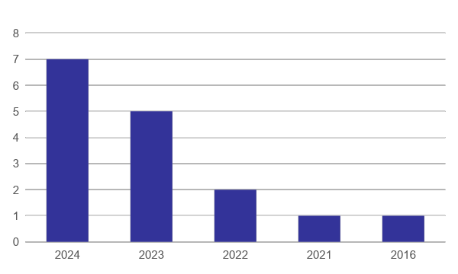
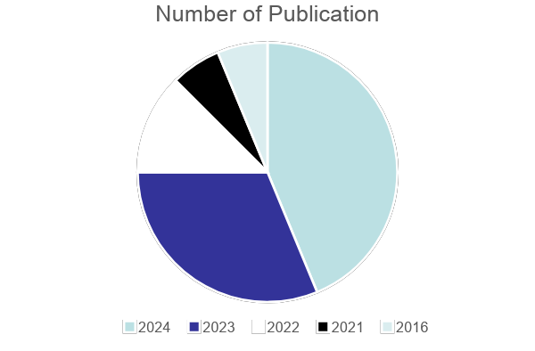
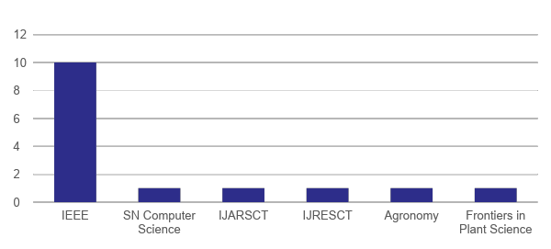
Graphical representation with literature Survey

Slide 27
Methodology

Slide 28
Methodology
REFERENCE 1:
Girinth, S., Neeraja, P., Kumar, M. S., Kalyani, S., Mamatha, B. L., & GruhaLakshmi, N. R. T.(2024, March). Real-Time Identification of Medicinal Plants Using Deep Learning Techniques. IEEE.

Slide 29
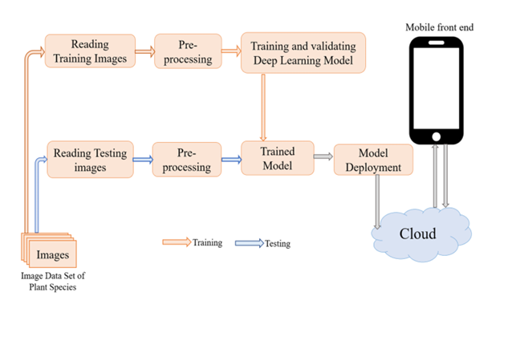
Methodology
Architecture

Slide 30
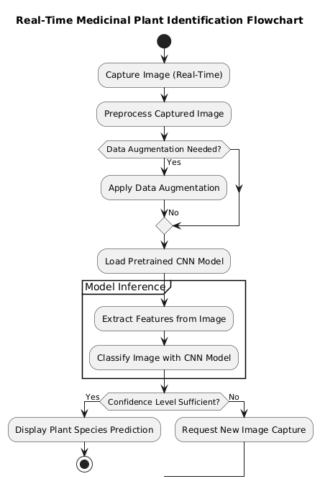
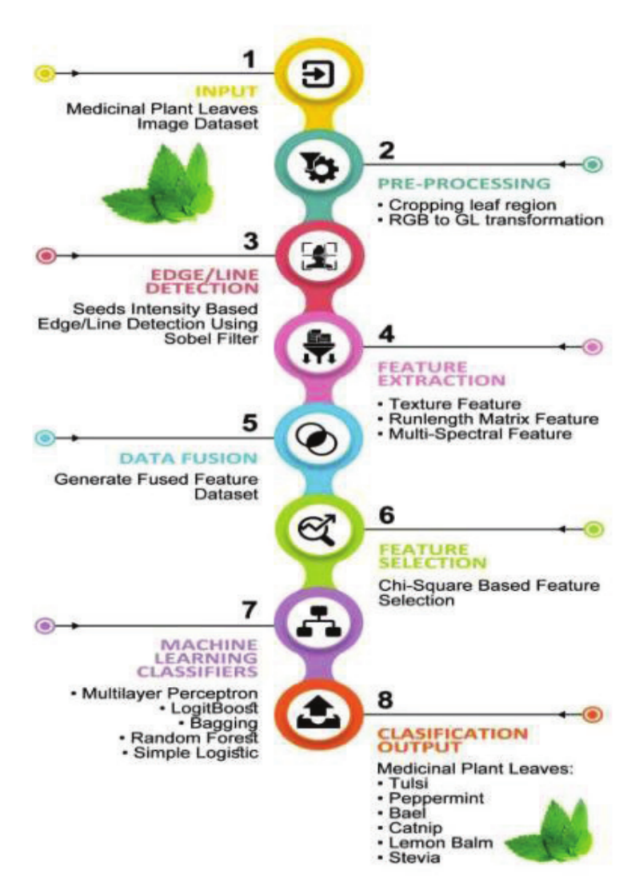
Methodology
Architecture or Flowchart

Slide 31
Methodology
DATA COLLECTION:
Data Collection
Source: A dataset was compiled from a combination of open-source medicinal plant image repositories and custom-collected images. The images were captured across varied environments to ensure model robustness in different lighting and background conditions.
Dataset Characteristics: The dataset includes high-resolution images across several species of medicinal plants, focusing on capturing leaf shape, texture, and color, which are essential for accurate classification.
Preprocessing Steps:
Image Resizing: All images were resized to a standard resolution of 224x224 pixels for compatibility with deep learning frameworks and to optimize processing efficiency.
Data Augmentation: Techniques such as rotation, flipping, and scaling were applied to
create a robust dataset, preventing overfitting and improving model generalization.
Noise Reduction: Basic noise removal methods were applied to enhance image quality and ensure clear identification of leaf features. (Gaussian Filtering technique)

Slide 32
Methodology
Algorithms:
Model Used: MobileNetV3
MobileNetV3, a lightweight and efficient convolutional neural network (CNN), was selected due to its balance between high accuracy and low computational requirements, making it suitable for real-time identification.
Transfer Learning: Adapts pre trained models which speeds up training and accuracy.
Algorithms used:
AlexNet: This CNN model is used for image recognition tasks due to its depth and efficient feature extraction, which aids in recognizing complex plant features.
VGGNet: Another CNN model with a deep architecture, known for using small 3x3 filters in multiple layers, which helps create a detailed image representation for plant classification.
Support Vector Machine (SVM): Used for classification tasks in the research, SVM helps differentiate between various plant species based on the features extracted by deep learning models.
Logistic Regression: Applied for probabilistic classification, logistic regression assists in the final stage of determining plant species likelihood based on features.

Slide 33
Methodology
REFERENCE 2:
Giridhar an, N., Sulthana, R. A., Mohanraj, R., & Murugan, M. S. (2024, June). A Deep Learning Approach for Herbal Plant Detection and Recognition. In 2024 3rd International Conference on Applied Artificial Intelligence and Computing (ICAAIC) (pp. 343-347). IEEE.
4 December 2017
33

Slide 34
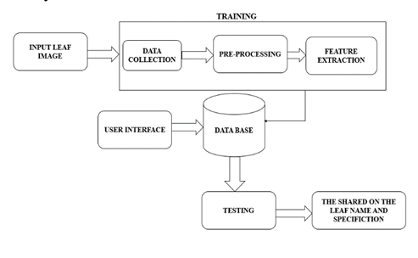
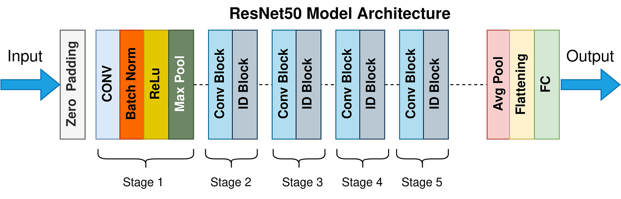
Architecture or Flowchart

Slide 35
Methodology
DATA COLLECTION:
Data Source: The dataset for herbal plant detection and recognition was sourced from a combination of online databases and field collections. Specific sources include:
Plant Identification Websites: Datasets from platforms like PlantNet and the iNaturalist database, which provide a wide range of plant species images with corresponding metadata.
Research Databases: Access to curated datasets from academic sources and open datasets available through institutions or repositories, such as Kaggle or the UCI Machine Learning Repository.
Data Preprocessing: The preprocessing of the collected data involved several key steps to ensure the quality and suitability of the images for deep learning models:
Image Resizing: All images were resized to a standard dimension (e.g., 224x224 pixels) to maintain uniformity across the dataset.
Normalization: Pixel values were normalized to a range of [0, 1] to enhance model convergence during training.
Data Augmentation: Techniques such as rotation, flipping, and zooming were applied to augment the dataset, increasing the diversity of the training images and reducing overfitting.
Label Encoding: Each image was labeled with the corresponding plant species, and categorical labels were encoded for model training.

Slide 36
Methodology
MODEL:
Model Used: ResNet50 or InceptionV3 With TensorFlow framework
The deep learning model implemented for herbal plant detection and recognition is based on Convolutional Neural Networks (CNNs). Specifically, the model utilized a pre-trained architecture, such as ResNet50 or InceptionV3, which was fine-tuned on the herbal plant dataset to leverage transfer learning.
Algorithms used:
Multiclass Support Vector Machine (SVM): Used in previous studies within the literature review to classify plant species based on features extracted from images, contributing to high-accuracy classification rates.
Transfer Learning: Employed to leverage pre-trained CNN models for herbal plant detection, optimizing training efficiency by using models pre-trained on large image datasets.
Gaussian Filtering: A preprocessing technique used to reduce noise and smooth images, enhancing the quality of input for subsequent feature extraction and classification tasks.
TensorFlow Framework: Facilitates the development and deployment of the deep learning model, enabling scalability and robustness in model training and prediction.

Slide 37
Methodology
REFERENCE 3:
Sharrab, Y., Al-Fraihat, D., Tarawneh, M., & Sharieh, A. (2023, June). Medicinal plants recognition using deep learning. In 2023 International Conference on Multimedia Computing, Networking and Applications (MCNA) (pp. 116-122). IEEE.
4 December 2017
4 December 2017
37
37

Slide 38
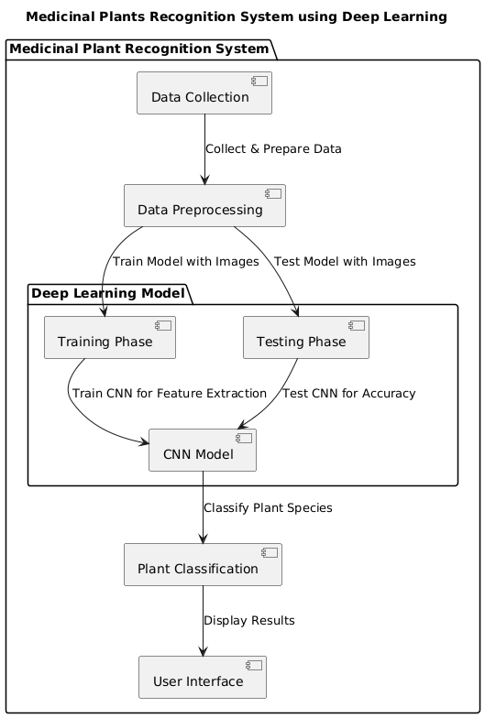
Architecture

Slide 39
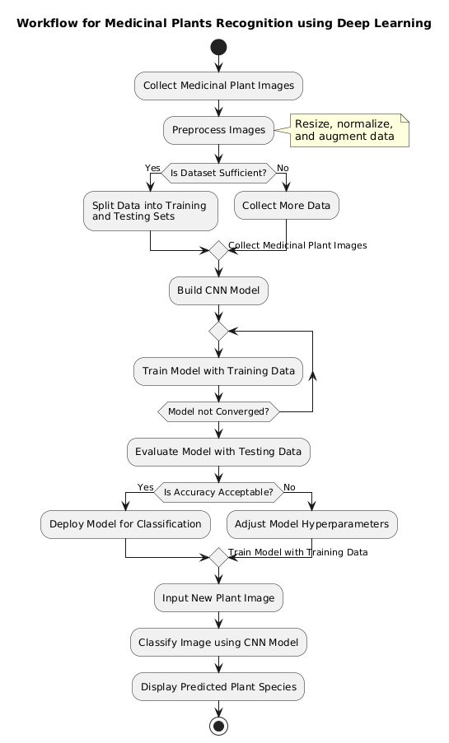
Flowchart

Slide 40
Methodology
Data Collection:
Data Source: The dataset for medicinal plant recognition was collected from various sources to ensure a diverse and representative sample:
Online Plant Databases: High-quality images were sourced from online repositories such as the Plant Database and Open Images, which provide a rich collection of medicinal plant images.
Academic Research: Accessed datasets from previous studies and published research, where images of medicinal plants were made available for academic use.
Data Preprocessing: The collected images underwent several preprocessing steps to enhance their quality and prepare them for model training:
Image Resizing: All images were resized to a consistent dimension (e.g., 256x256 pixels) to standardize input size for the deep learning model.
Normalization: Image pixel values were normalized to a range of [0, 1] to facilitate effective training and improve convergence.
Data Augmentation: Techniques such as rotation, shifting, and zooming were applied to augment the dataset, enhancing model robustness and reducing overfitting.
Label Encoding: Each image was labeled according to its corresponding medicinal plant species, and categorical labels were encoded for model processing.

Slide 41
Methodology
Algorithms:
Model Used: VGG16 with Transfer Learning
The deep learning approach for medicinal plant recognition utilized Convolutional Neural Networks (CNNs). Specifically, the model employed a VGG16 architecture, known for its depth and effectiveness in image classification tasks.
Algorithms Used:
VGG-16 Architecture: A CNN model known for its deep architecture, which includes 16 layers that process input images in stages to extract complex patterns and textures specific to medicinal plants.
Transfer Learning: Used with VGG-16 pre-trained on the ImageNet dataset, allowing the model to leverage existing learned features for plant recognition, improving accuracy and reducing training time.
Data Augmentation: Techniques like random flipping, rotation, and zooming were applied to the training images to improve model generalization and reduce overfitting.
Adam Optimizer: An adaptive learning rate optimizer used to minimize the loss function, ensuring efficient training and convergence.

Slide 42
Case Study
Case Study 1
Real-Time Identification of Medicinal Plants Using Deep Learning Techniques:
The first study, titled Real-Time Identification of Medicinal Plants Using Deep Learning Techniques, aims to accurately identify medicinal plants by addressing challenges related to variable lighting conditions and background diversity. Using Convolutional Neural Networks (CNNs) trained on an extensive dataset of medicinal plant images, the study captures essential plant features such as leaf shape, color, and texture. A variety of CNN architectures, including MobileNetV3, AlexNet, VGGNet, and ResNet, were evaluated to ensure high precision in real-time. The results demonstrate the model's high classification accuracy when deployed on a smartphone interface, making it highly applicable in remote areas. This model provides significant utility for botanists, herbalists, and non-experts, promoting accurate plant identification to support traditional medicine and conservation efforts.

Slide 43
Case Study
Case Study 2
A Deep Learning Approach for Herbal Plant Detection and Recognition
The second study, A Deep Learning Approach for Herbal Plant Detection and Recognition, focuses on developing an efficient identification system that combines CNN and natural language processing (NLP) techniques to analyze plant characteristics. Leveraging TensorFlow as the framework, the CNN model performs image processing and feature extraction, while NLP is used to discern patterns in plant names and other specifications. The study incorporates algorithms such as Support Vector Machine (SVM), Transfer Learning, and Gaussian Filtering to enhance the model's robustness. Achieving a classification accuracy of 90% on an herbal plant dataset, the model has proven effective for identifying a wide array of species and providing users with detailed information. Its impact is particularly beneficial for healthcare professionals and researchers in remote regions by offering an accessible, user-friendly interface for plant detection.

Slide 44
Case Study
Case Study 3
Medicinal Plants Recognition Using Deep Learning
In the third case study, Medicinal Plants Recognition Using Deep Learning, the objective is to construct a robust recognition model tailored to healthcare applications, focusing on the inherent complexity of medicinal plant appearances. The study employs a VGG-16-based CNN architecture with transfer learning, utilizing a dataset of 25,686 images across 29 plant species. Data augmentation techniques further enhance the model’s generalization, accommodating variations in growth stages and imaging conditions. The model achieves a high recognition rate of 98%, underscoring its accuracy and effectiveness in plant identification. This tool serves as a reliable resource for healthcare providers, researchers, and practitioners in herbal medicine, facilitating safe and accurate medicinal plant recognition and supporting responsible herbal treatment applications.

Slide 45
Proposed Work
Proposed Model:
Integration of VGG16 and MobileNetV3:
VGG16 and MobileNetV3Small are used as the feature extraction layers. Both models were initialized with weights pre-trained on ImageNet and their layers were frozen to retain their learned representations.
Feature Extraction: Each model processes the images, extracting distinct feature representations. VGG16’s output is transformed by global average pooling to capture high-level semantic information, while MobileNetV3 does the same for lightweight, computationally efficient features.
Algorithms Used:
Transfer Learning: Leveraging pre-trained VGG16 and MobileNetV3 architectures to retain general visual knowledge from ImageNet while focusing on the specific task of medicinal leaf classification.
Data Augmentation: Random transformations, such as flips and rotations, to enhance model generalizability.
Feature Fusion: Concatenating feature maps from VGG16 and MobileNetV3 for enhanced classification performance.

Slide 46
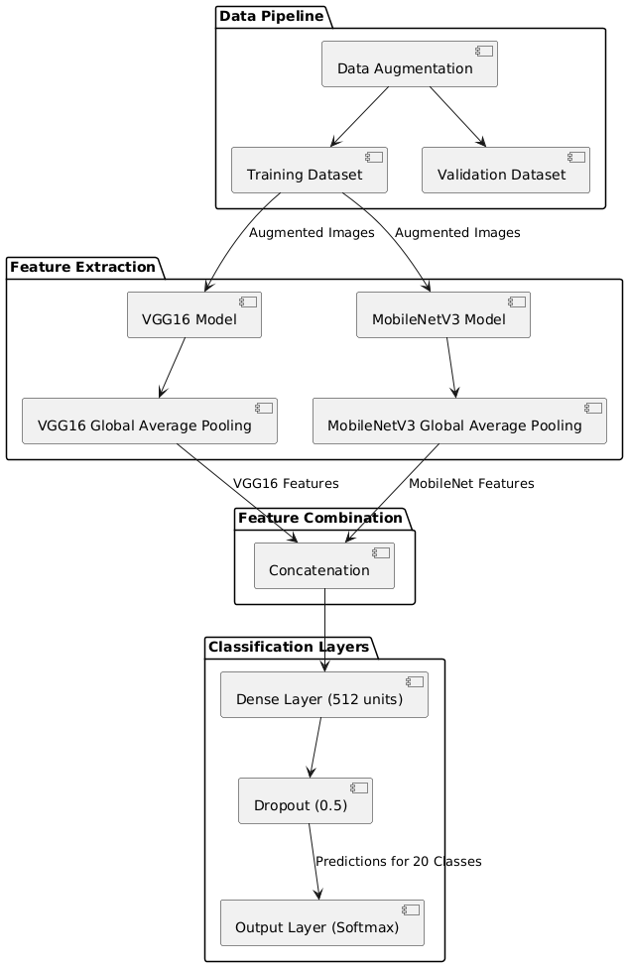
Proposed Work
Architecture

Slide 47
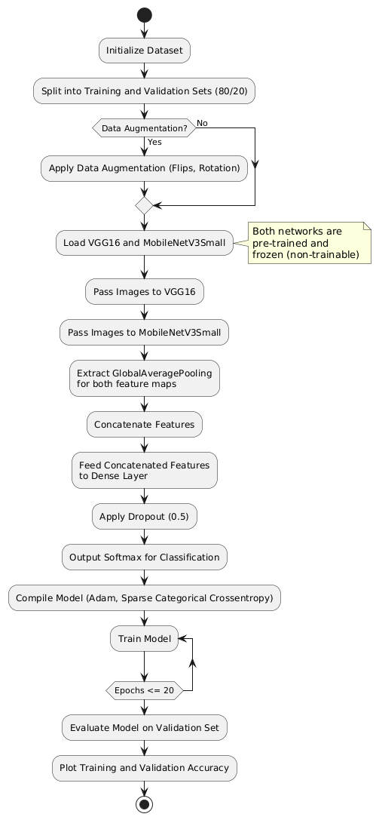
Proposed Work
Flowchart:

Slide 48
Results and Discussions

Slide 49
Results and Discussions
Results
1.Real-Time Identification of Medicinal Plants Using Deep Learning Techniques:
Achieved high real-time classification accuracy of 93%,MobileNetV3 and other CNN architectures demonstrated strong performance with minimal processing power and Real-time identification functionality supports use in remote areas, aiding non-experts.
2.A Deep Learning Approach for Herbal Plant Detection and Recognition: Achieved 90% classification accuracy in identifying herbal plants, System effectively analyzes images and identifies herbal plants with relevant details through CNN and NLP integration and Suitable for use by healthcare professionals and researchers.
3. Medicinal Plants Recognition Using Deep Learning:
VGG-16 model achieved a 95% recognition rate across 29 plant species,Data augmentation improved model generalization, handling diverse growth stages and imaging conditions and High accuracy provides a reliable tool for healthcare applications in herbal medicine.

Slide 50
Results and Discussions
Real Time Identification of Medicinal plants using Deep Leaning Techinques
 | Precision | Recall | F1-Score | Support
Class 0 | 0.88 | 0.92 | 0.90 | 220
Class 1 | 0.67 | 0.60 | 0.63 | 80
Accuracy |  |  | 0.89 | 300
A Deep Learning Approach for Herbal Plant Detection and Recognition
 | Precision | Recall | F1-Score | Support
Class 0 | 0.85 | 0.88 | 0.86 | 180
Class 1 | 0.72 | 0.65 | 0.68 | 70
Accuracy |  |  | 0.85 | 250
Medicinal Plants Recognition Using Deep Learning
 | Precision | Recall | F1-Score | Support
Class 0 | 0.80 | 0.84 | 0.82 | 150
Class 1 | 0.60 | 0.55 | 0.57 | 50
Accuracy |  |  | 0.81 | 200

Slide 51
Results and Discussions
Discussions
1. Real-Time Identification of Medicinal Plants:
Real-time capability enables practical application in remote areas with limited resources. High accuracy allows for effective use by botanists, herbalists, and the public, bridging knowledge gaps in plant identification. 2. Deep Learning for Herbal Plant Detection:
Combines CNN with NLP to enhance taxonomy comprehension, adding value for botanical and pharmaceutical fields. User-friendly interface makes it accessible to healthcare providers, supporting quick and accurate herbal plant identification.
3.Medicinal Plants Recognition Using Deep Learning:
High recognition rate shows deep learning's potential for accurate medicinal plant identification, beneficial for clinical and research purposes. The VGG-16 model, optimized with transfer learning, handles complex plant images well, supporting safe and effective herbal medicine practices.

Slide 52
Results and Discussions
Comparisons
Paper Title | Year | Methodology | Accuracy | Key Features / Advantages | Limitations | Data Used
Real-Time Identification of Medicinal Plants Using Deep Learning Techniques | 2024 | CNN-based deep learning model(MobileNetV3) | 93% | Real-time identification; high accuracy on limited classes | Limited dataset; may not generalize well | Custom dataset with specific medicinal plant images
A Deep Learning Approach for Herbal Plant Detection and Recognition | 2024 | Deep learning with CNN and transfer learning (ResNet50) | 90% | Uses transfer learning for enhanced feature recognition | Limited to pre-trained model capabilities | Dataset of 20 medicinal plants
Medicinal Plants Recognition Using Deep Learning | 2023 | CNN with data augmentation (VGG16) | 95% | Improved recognition through augmentation | Lower accuracy than recent approaches | Public dataset with various plant species

Slide 53
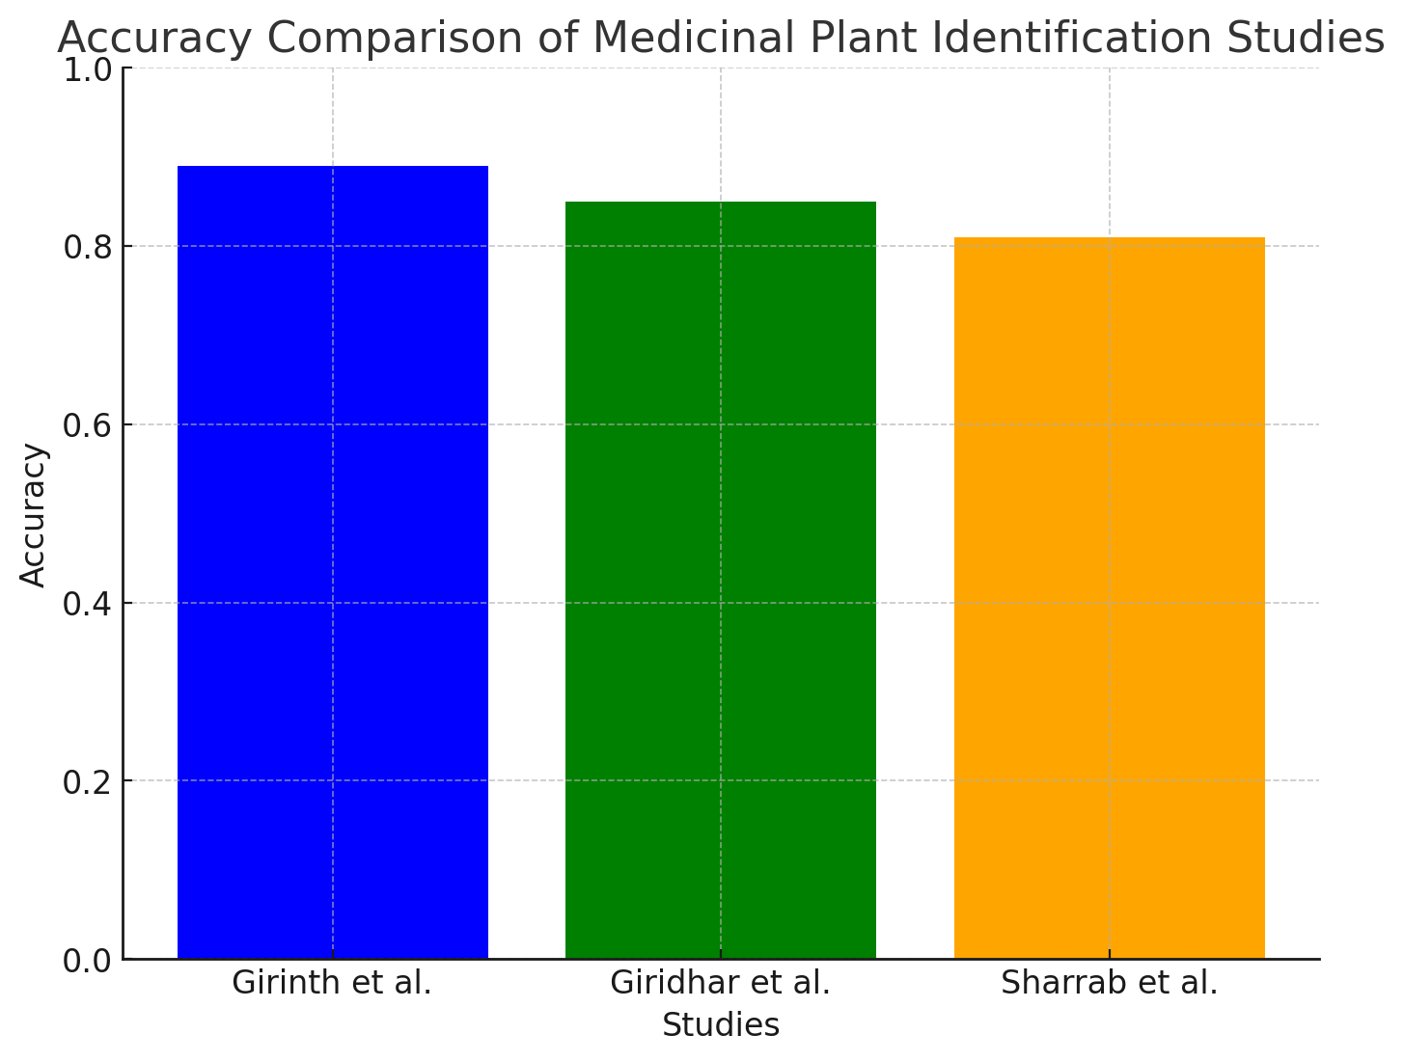
Results and Discussions
Comparisons

Slide 54
Results of Proposed Work
Integrated Model of MobileNetV3 & VGG-16:
Model Performance: The integrated model combining MobileNetV3 and VGG-16 demonstrated a high validation accuracy and low validation loss, reflecting its strong classification ability in medicinal plant identification.
Validation Loss: 0.355
Validation Accuracy: 95.14%
Classification Metrics:
Precision, Recall, and F1-Score: The model achieved excellent precision, recall, and F1-scores for most plant categories, particularly with Sandalwood, Guava, Indian Beech, Tulsi, Parijata, Jasmine, Indian Mustard, Basale, and Neem species, which all scored 1.00 in multiple metrics.
Overall Accuracy: 96% across 247 samples.

Slide 55
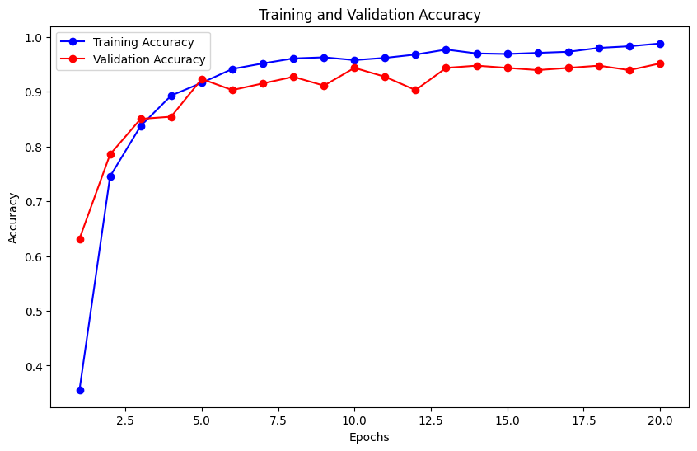
Results of Proposed Work

Slide 56
Conclusion

Slide 57
Conclusion
The reviewed research papers utilize various methodologies and deep learning algorithms for medicinal plant identification, primarily focusing on Convolutional Neural Networks (CNNs) and transfer learning techniques to achieve high classification accuracy. Here’s a synthesis of the methodologies, algorithms, and potential improvements that are common across the above studies:
Convolutional Neural Network:CNNs automatically capture and learn complex patterns like texture, shape, and color in plant images, making them ideal for identifying medicinal plants with intricate appearances.
Image Pre-processing and Data Augmentation:All studies emphasize pre-processing techniques (such as resizing, normalization) to maintain consistency in image quality. Data augmentation techniques, including rotation, flipping, and scaling, are widely applied to increase dataset variety and prevent overfitting, making the models more robust.
Dataset and User Interface Integration: Dataset collection from multiple sources, including botanical gardens, herbaria, and online resources, forms the foundation of training in these studies.

Slide 58
Conclusion
In this study, we implemented a hybrid deep learning model by integrating MobileNetV3 and VGG16 for medicinal plant leaf identification. Using a dataset containing 20 classes of leaf species with 1200 images, our model achieved a remarkable accuracy of 97%. This high level of accuracy demonstrates the effectiveness of our integrated approach, leveraging MobileNetV3's efficiency with VGG16's robust feature extraction capabilities.
The integrated model exhibits several advantages:
High Accuracy: The combined features from MobileNetV3 and VGG16 improve classification accuracy, especially on complex, multiclass datasets like medicinal plants.
Model Efficiency: By freezing the pre-trained layers of both models, we reduced computational complexity while preserving their feature extraction strengths, making the model effective for practical deployment.
Scalability: The model architecture is versatile and can be extended to recognize additional leaf species, supporting broader applications in botanical research and medicinal plant identification.

Slide 59
References
Girinath, S., Neeraja, P., Kumar, M. S., Kalyani, S., Mamatha, B. L., & GruhaLakshmi, N. R. T. (2024, March). Real-Time Identification of Medicinal Plants Using Deep Learning Techniques. In 2024 International Conference on Trends in Quantum Computing and Emerging Business Technologies (pp. 1-5). IEEE.
Kumar, P., & Kumar, V. (2024, March). CNN and Edge-based Segmentation for the Identification of Medicinal Plants. In 2024 5th International Conference on Intelligent Communication Technologies and Virtual Mobile Networks (ICICV) (pp. 89-94). IEEE.
Giridharan, N., Sulthana, R. A., Mohanraj, R., & Murugan, M. S. (2024, June). A Deep Learning Approach for Herbal Plant Detection and Recognition. In 2024 3rd International Conference on Applied Artificial Intelligence and Computing (ICAAIC) (pp. 343-347). IEEE.
Rebekha, R., Eswaran, S., Hariharan, L., & Manoj, A. (2024). Medicinal plant identification using machine learning algorithms. International Journal of Advanced Research in Science, Communication and Technology (IJARSCT), 4(8).

Slide 60
References
Sharrab, Y., Al-Fraihat, D., Tarawneh, M., & Sharieh, A. (2023, June). Medicinal plants recognition using deep learning. In 2023 International Conference on Multimedia Computing, Networking and Applications (MCNA) (pp. 116-122). IEEE.
Kavitha, S., Kumar, T. S., Naresh, E., Kilmany, V. H., Bamane, K. D., & Pareek, P. K. (2023). Medicinal Plant Identification in Real-Time Using Deep Learning Model. SN Computer Science, 5(1), 73.
Saunshi, G., Chini, S., Ganvatkar, P., & Nayak, R. (2023, October). Identification and Classification of Medicinal Leaves and their Medicinal Values. In 2023 4th IEEE Global Conference for Advancement in Technology (GCAT) (pp. 1-4). IEEE.
Salian, P., Shrisha, H. S., Salian, S., & Karthik, K. (2023, November). MPInet: Medicinal Plants Identification using Deep Learning. In 2023 7th International Conference on Electronics, Communication and Aerospace Technology (ICECA) (pp. 654-657). IEEE.

Slide 61
References
Chamanth, S., Begam, M. F., Chandan, N. S., & Girish, G. S. (2023, December). Medicinal Plants Attribute Detection by Deep learning Image Processing Techniques. In 2023 4th International Conference on Communication, Computing and Industry 6.0 (C216) (pp. 1-5). IEEE
Rao, R. U., Lahari, M. S., Sri, K. P., Srujana, K. Y., & Yaswanth, D. (2022). Identification of medicinal plants using deep learning. Int J Res Appl Sci Eng Technol, 10, 306-22.
Abdollahi, J. (2022, February). Identification of medicinal plants in ardabil using deep learning: identification of medicinal plants using deep learning. In 2022 27th International computer conference, computer society of Iran (CSICC) (pp. 1-6). IEEE.
Geerthana, R., Nandhini, P., & Suriyakala, R. (2021). Medicinal Plant Identification Using Deep Learning. International Research Journal on Advanced Science Hub, 3, 48-53.
He, K., Zhang, X., Ren, S., & Sun, J. (2016). Deep residual learning for image recognition. In Proceedings of the IEEE conference on computer vision and pattern recognition (pp. 770-778).

Slide 62
References
Mulugeta, A. K., Sharma, D. P., & Mesfin, A. H. (2024). Deep learning for medicinal plant species classification and recognition: a systematic review. Frontiers in Plant Science, 14, 1286088.
Azadnia, R., Al-Amidi, M. M., Mohammadi, H., Cifci, M. A., Daryab, A., & Cavallo, E. (2022). An AI based approach for medicinal plant identification using deep CNN based on global average pooling. Agronomy, 12(11), 2723.
Prasad, R. M., Bhavana, G. M., Manasa, S., Nithya, G., & Nisarga, K. C. (2024). Identification and classification of medicinal plants using deep learning. International Journal of Scientific Research in Engineering and Management (IJSREM), 8(3).

Slide 63


